Slide 1
HTML Intermediate Multi-pages Website
Web Design Crash Course

Slide 2
Today’s objectives
Computer File Paths
What are Webpages?
HTML Boilerplate
Food Ranking using HTML
HTML Portfolio Website

Slide 3

Attendence

Slide 4
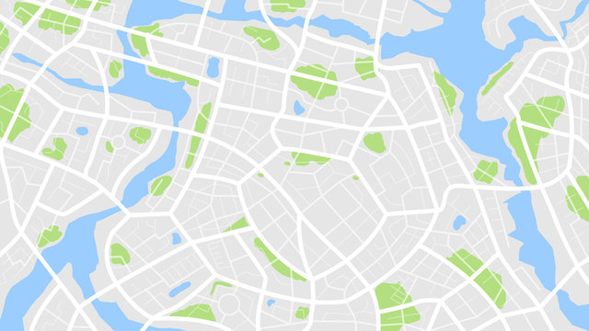

1. Computer File Paths
Location
Go to: KH/Phnom Penh/Toul Kork/Institute of Technology of Cambodia
Think of File Path as a unique location, for a file or a folder on your computer.
Similarly, we can use file path on a computer to direct to the computer in the hard drive

Slide 5
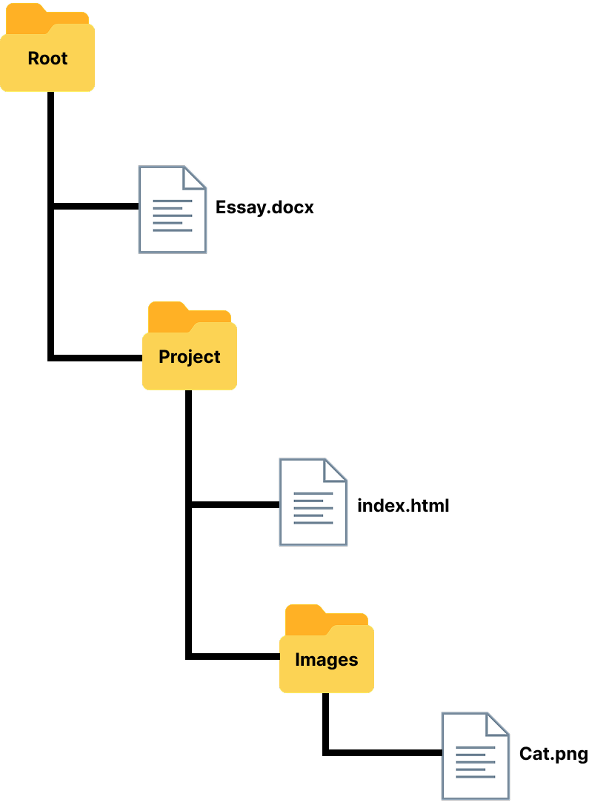
1. Computer File Paths
A simple structure of the storage on a computer:
Files Vs. Folders

Slide 6

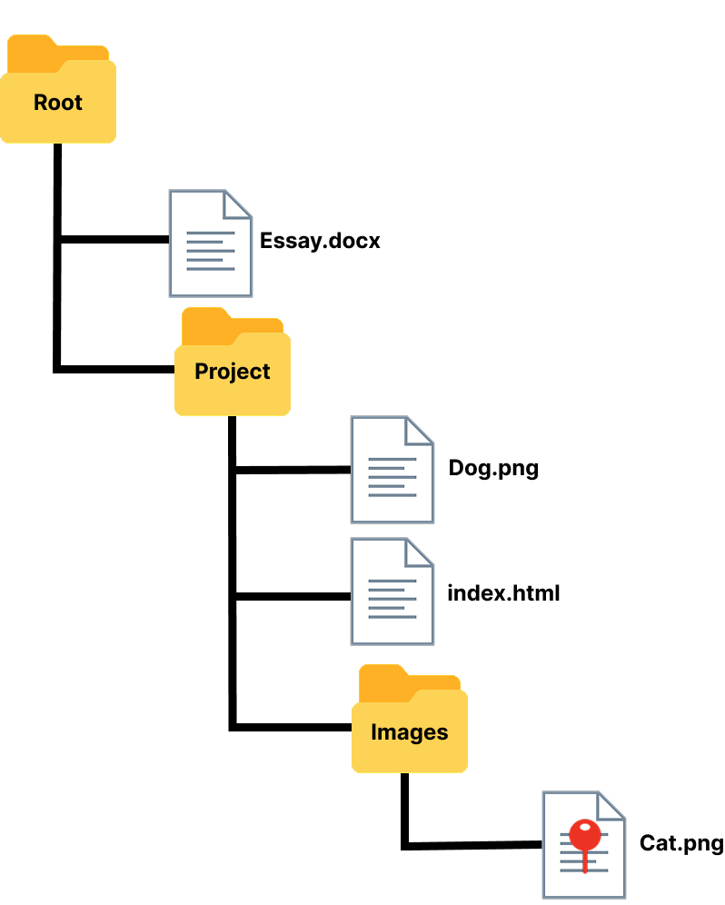
1. Computer File Paths
Absolute Vs. Relative
Absolute File Path
C:/Project/Images/Cat.png
(On Windows)
/Project/Images/Cat.png
(On Mac)

Slide 7
1. Computer File Paths
Absolute Vs. Relative
Relative File Path (good choice for developer)
Images/Cat.png
Shorter
Still valid, even we move folders around

Slide 8


1. Computer File Paths
Absolute Vs. Relative
Relative File Path — Special Characters
./Dog.png
To stay within current directory, and look over there!

Slide 9
1. Computer File Paths: Practice
Instructions:
1. Download the zip folder
2. Extract it in your computer
3. Open the folder (extracted) in your VSCode
4. Start to do it

Slide 10
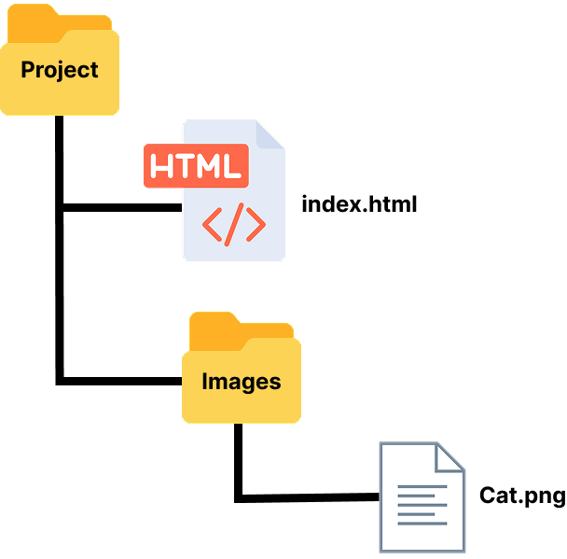
2. What are Webpages?
A Website

Slide 11

2. What are Webpages?
Building Multi-Page Websites
<a src=“/about.html”>About Page</a>
index.html
about.html
contact.html

Slide 12
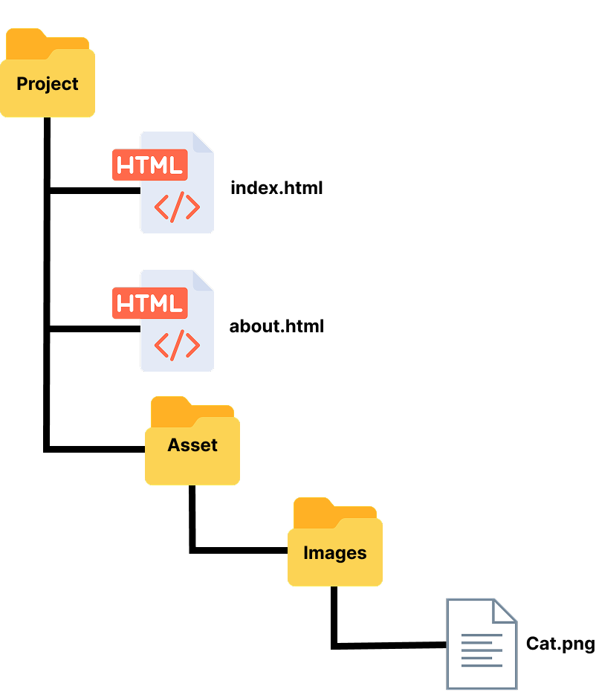
2. What are Webpages?
Building Multi-Page Websites
<a src=“./about.html”>About Page</a>

Slide 13
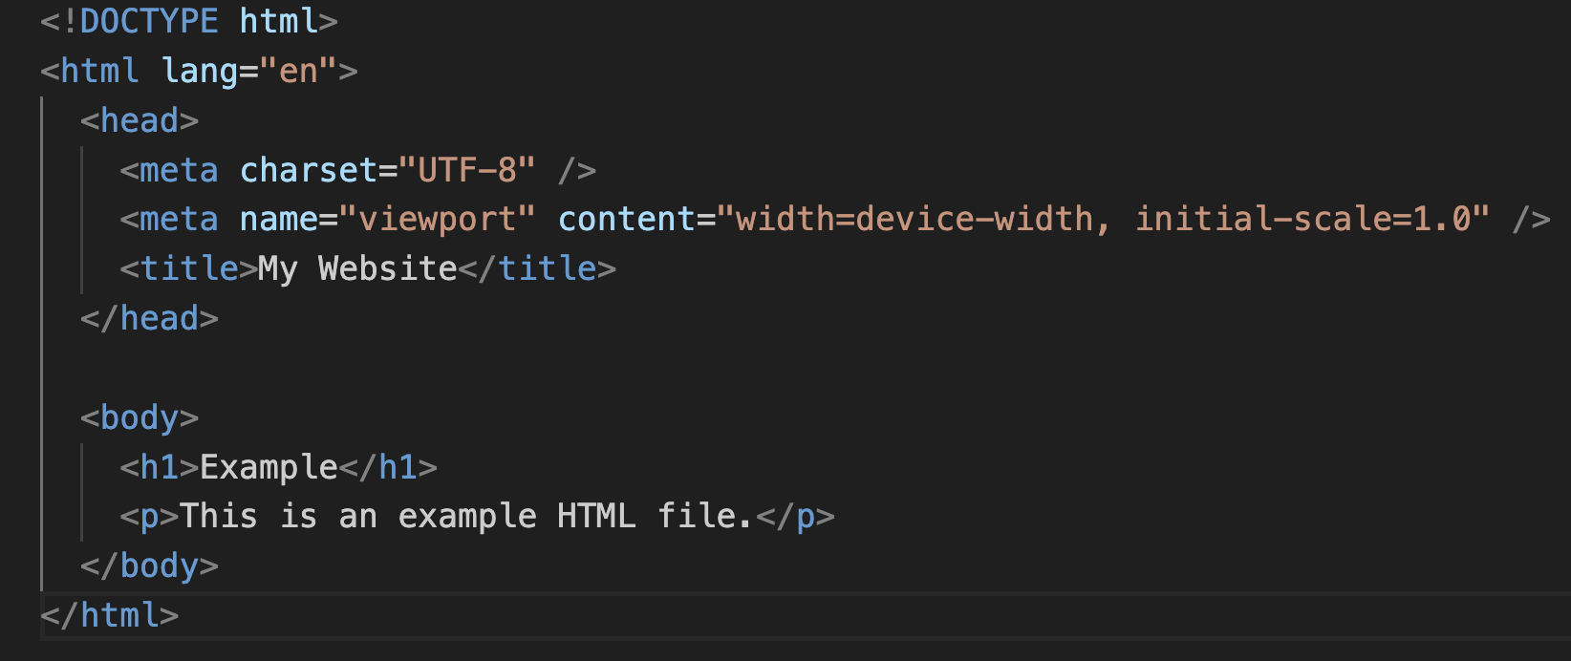
3. HTML Boilerplate

Slide 14
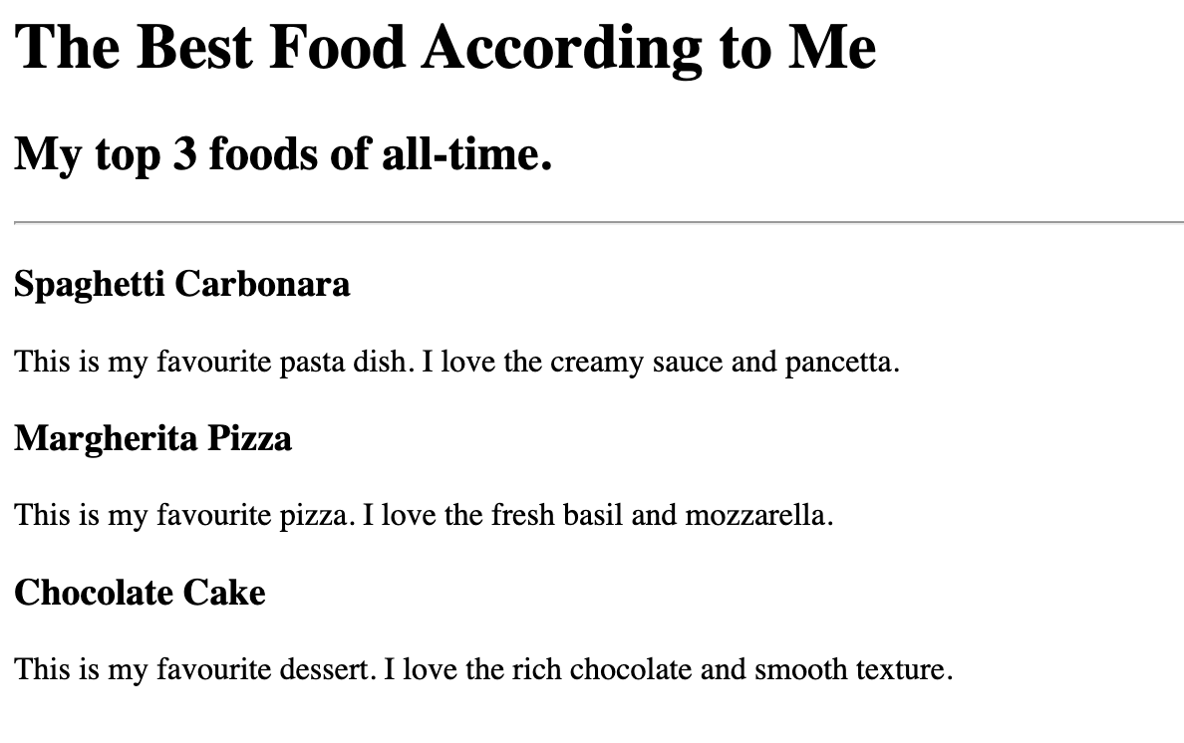
4. HTML : Food Ranking Exercise

Slide 15
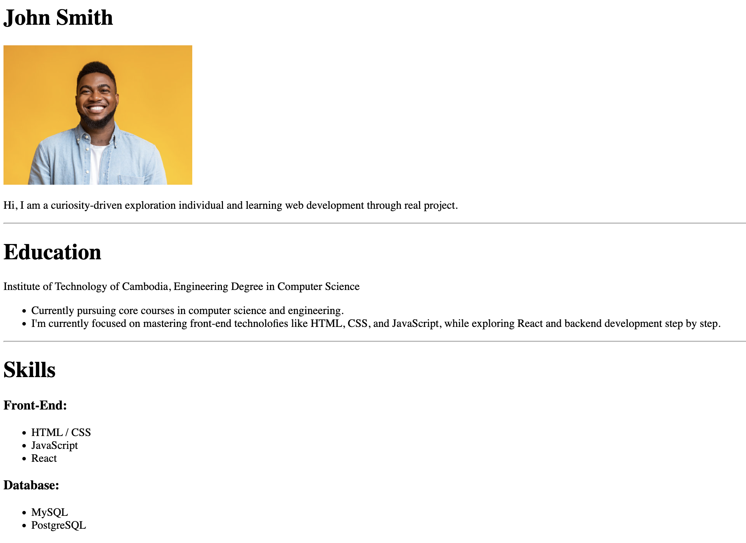
5. HTML Portfolio Website

Slide 16
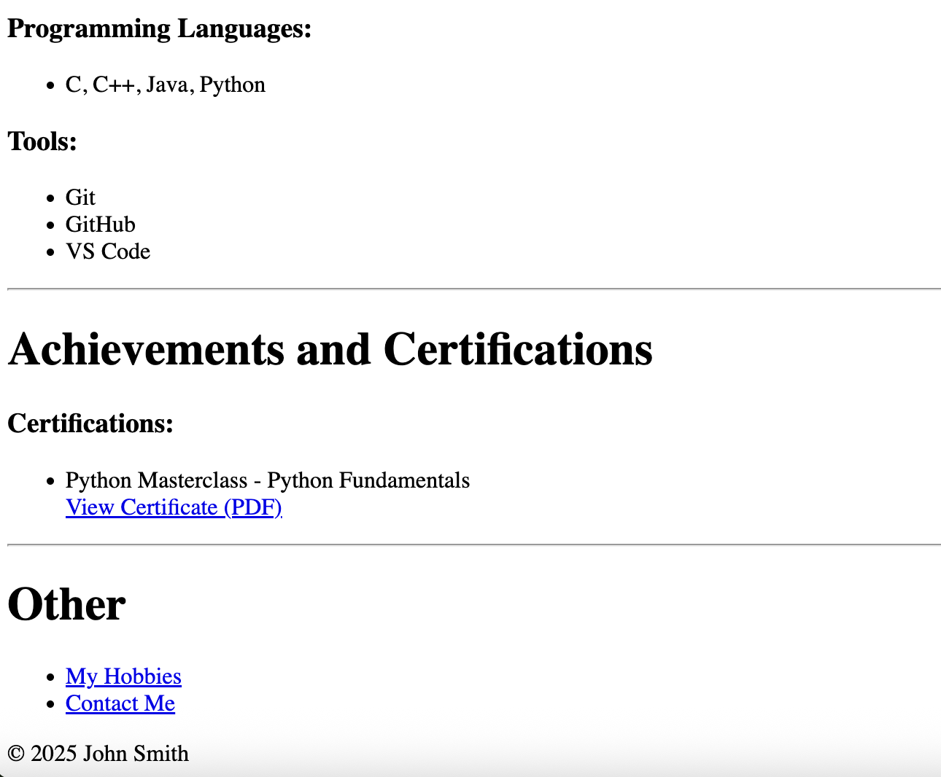
5. HTML Portfolio Website

